Slide 1

Unit 10

Slide 2
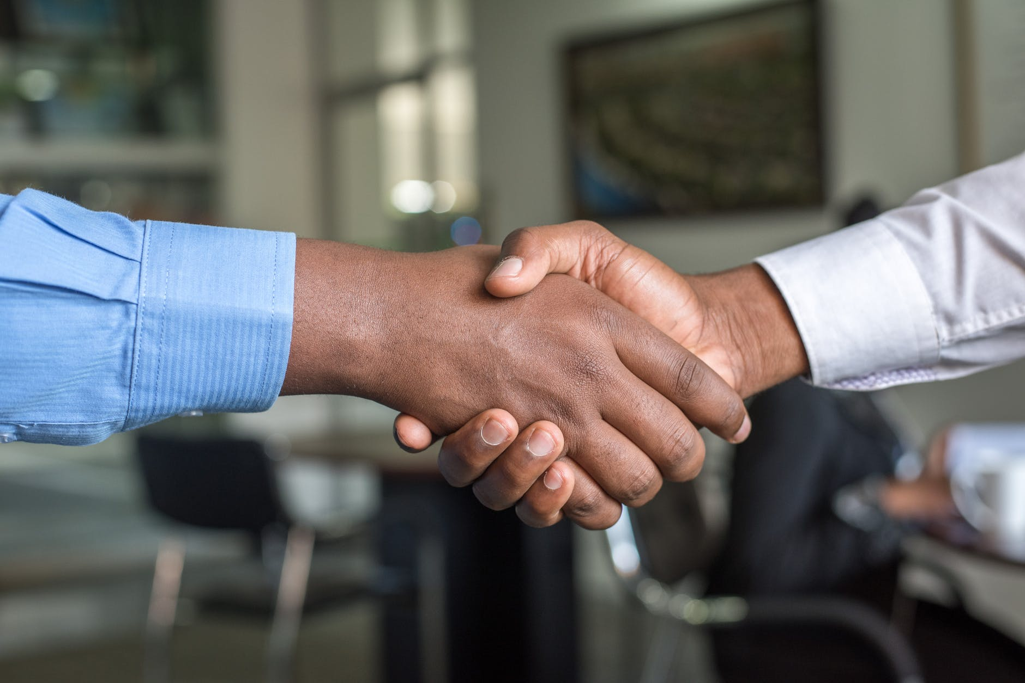
Unit 10
You're supposed to shake hands.

Slide 3
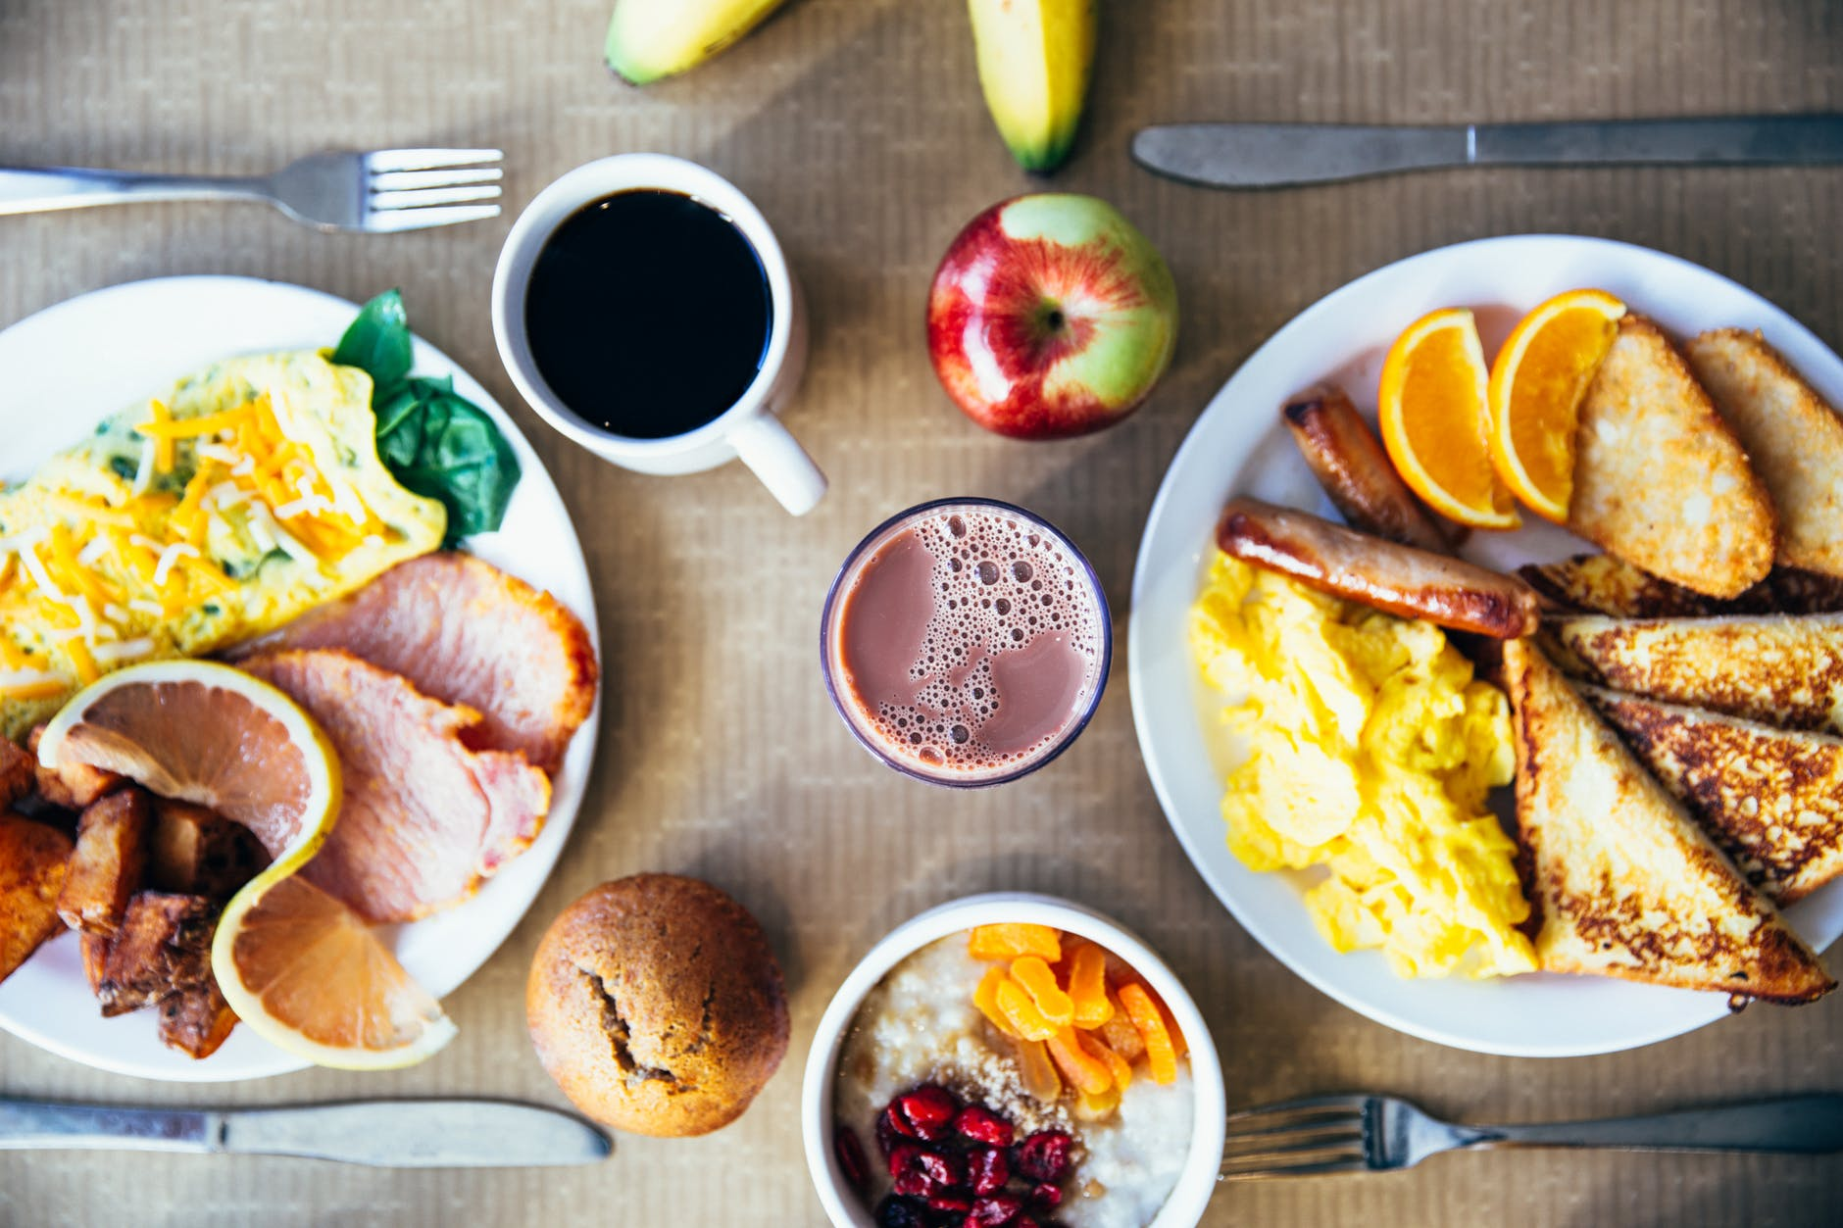


Slide 4
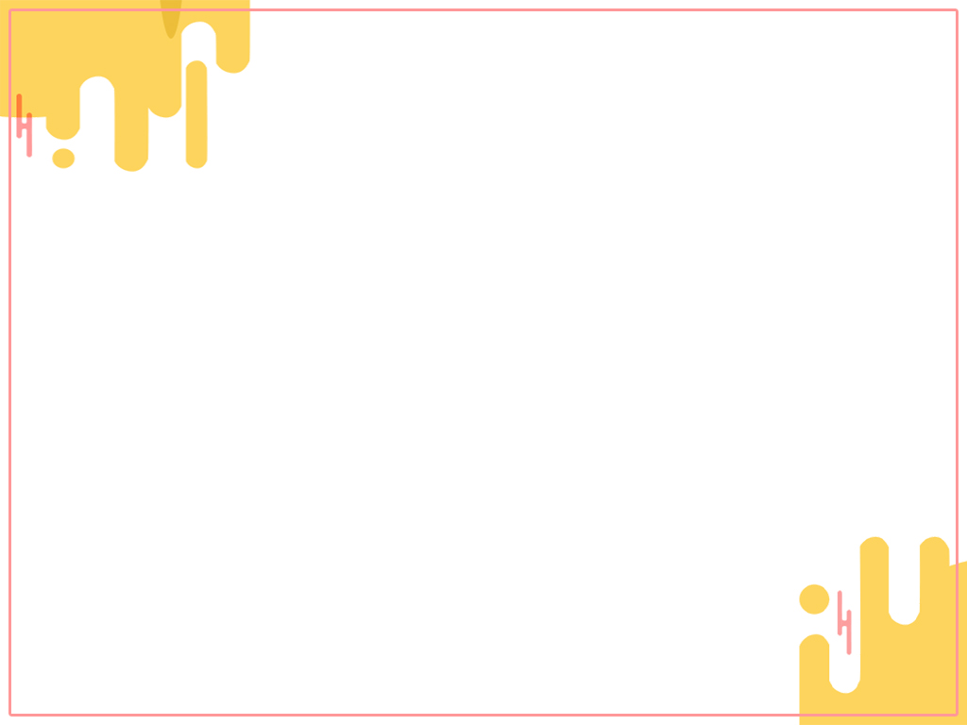


To learn the table manners in France.
To learn new words: basic, exchange,
teenage, behave, except…
To talk about the table manners you know.

Slide 5


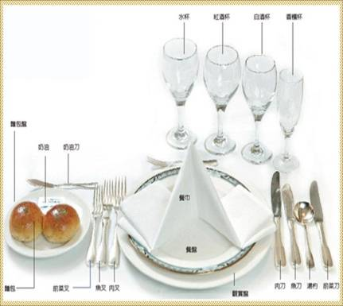
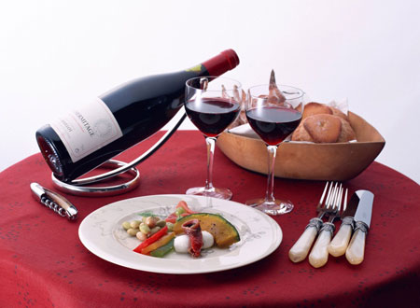
How much do you know about table manners in western countries?

Slide 6

2a
What do you know about customs in foreign countries? What do you think is the biggest challenge when visiting a foreign country?

Slide 7

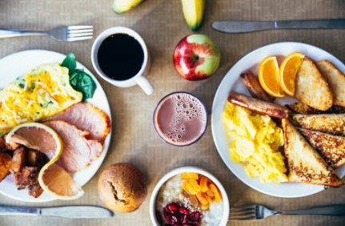
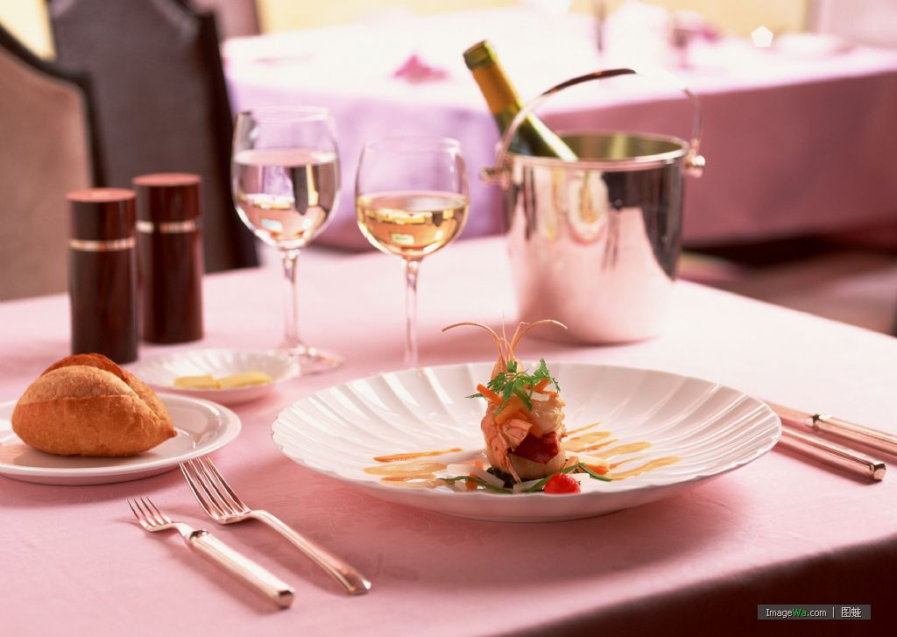
My cousin went to America, and she said
that learning basic table manners was her
biggest challenge. She never knew what she
was supposed to do at the dinner table.

Slide 8
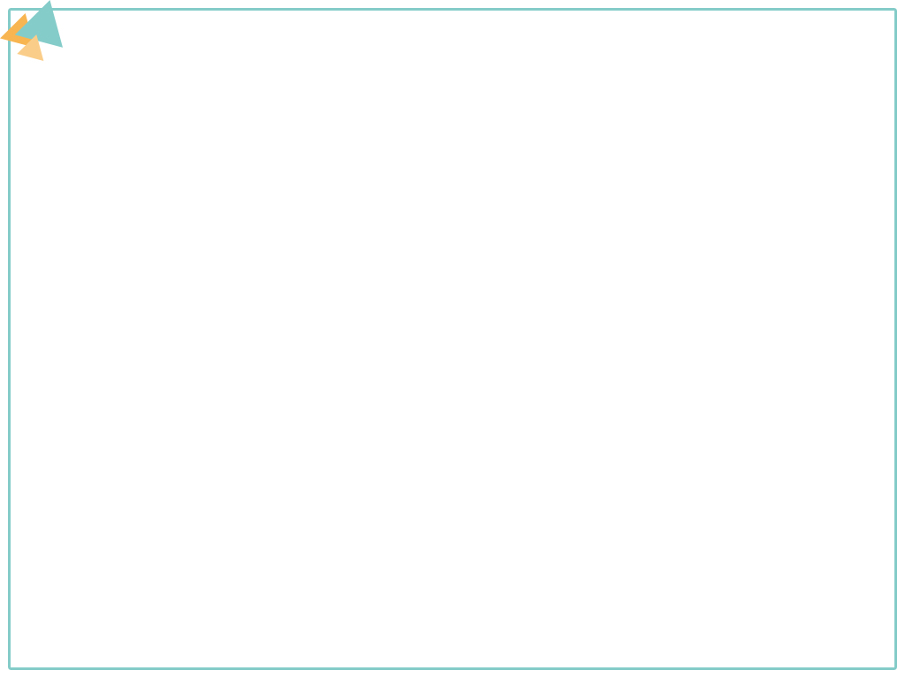

What is the topic sentence for each paragraph?

Slide 9
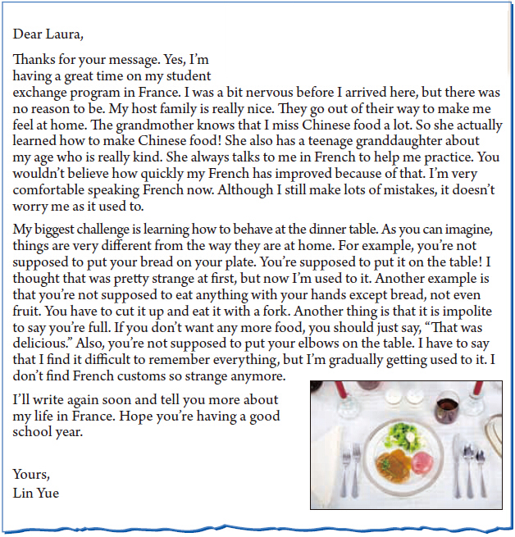
topic sentence
topic sentence
解释说明

Slide 10

2b
Read the letter and answer the questions.
1. Why is Lin Yue in France?
She is on a student exchange program.

Slide 11
2. Does she enjoy staying with her host family? How do you know?
Yes, she does. This can be seen in the way she talks about her host family: that they are nice and they go out of their way to make her feel at home; that the grandmother make Chinese food for her; that the granddaughter is kind and talks to her in French to give her practice.

Slide 12
3. How does she feel about making mistakes when she speaks French?
4. What is the biggest challenge she is facing?
It doesn’t worry her as it used to.
Her biggest challenge is how to behave at the dinner table.

Slide 13
Fill in the blanks according to para. 1.
Lin Yue went to France for a student exchange program. Before she arrived there, she was a bit _______, but in fact, things went well with her. Her (1) _____ ______ tried very hard to make her feel at home. The grandmother learned to make (2) _______ _____ for her.
nervous
host family
Chinese food
The kind granddaughter always helped her practice French. Now she is (3)
__________ ________ ______ although she still makes lots of mistakes.
comfortable speaking French

Slide 14
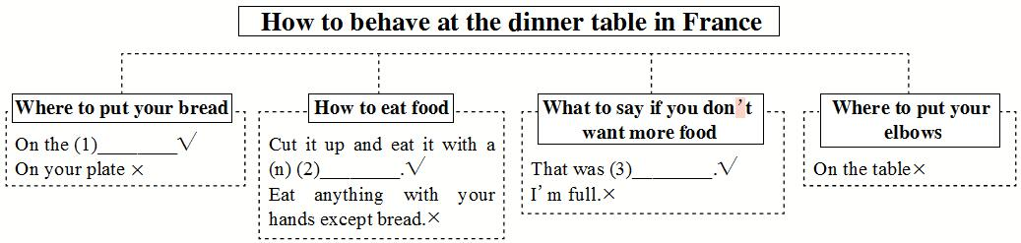
Complete the chart according to para. 2.
table
fork
delicious

Slide 15

2c
Guess the words you don’t know when you read the passage.
Read the sentences and replace the underlined words with the phrases in the box.

Slide 16
1. Making mistakes in French used to make Lin Yue nervous. 2. It was quite hard for her to feel good about speaking French. 3. The host family tried very hard to help Lin Yue. 4. Lin Yue has slowly learned how to be like her French friends. | ● went out of their way ● be comfortable (doing) ● gradually gotten used to being ● (something) worry (someone)

Slide 17
Review the passage and make notes about French customs in the chart.
2d
Dos | Don’ts
You’re expected to put your bread on the table.
You’re not supposed to put your bread on your plate.
You’re expected to cut up your fruit and eat it with a fork.
You’re not supposed to eat anything with your hands except bread.
You’re not supposed to say you’re full.
You’re expected to say “That was delicious” if you don’t want any more food.
You’re not supposed to put your elbows on the table.

Slide 18
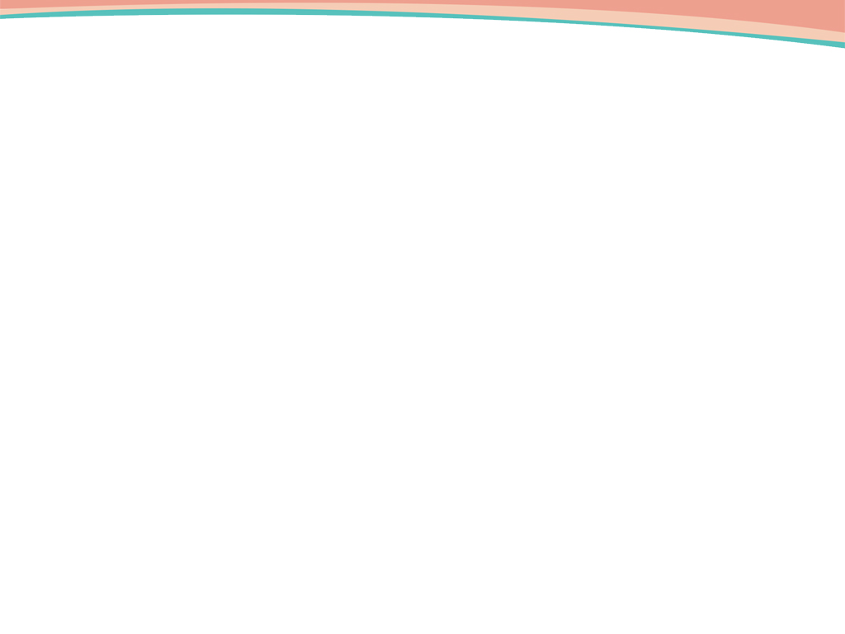
2e
1. Compare the table manners in France and China in your group. How are they the same or different? Make a list.
2. Share your ideas with your class.
e.g. In France, people put their bread on the table. But in China, we always put our food on a plate or in a bowl. We never put food on the table.

Slide 19

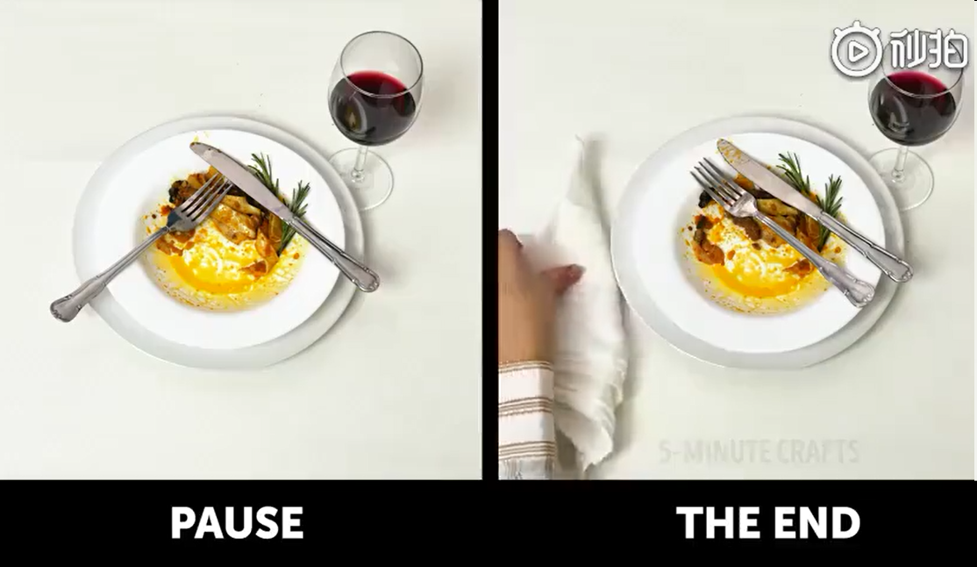
Watch a video and learn more about table manners.

Slide 20


因……而感谢
寄宿家庭
特地；格外努力
使……感到宾至如归
和某人年龄相仿
轻松做某事
最大的挑战
学习如何在餐桌上
表现得体
thanks for ...
host family
go out of one’s way
make ... feel at home
about one’s age
be comfortable doing sth.
the biggest challenge
learn how to behave at the dinner table

Slide 21
和……不同
习惯于
切碎
举止得体
be different from ...
get used to
cut up
behave properly

Slide 22

Ⅰ. 根据句意及提示，写出句中所缺单词。
1. Steve _________(举止) badly when he was young.
2. The restaurant is open every day _________(除……之外) Sunday.
3. The three _________(交换) students in my class are from America.
4. As a doctor, you should give the poor people _________(基础的) medical help.
behaved
except
exchange
basic

Slide 23
5. Mrs. Trent was surprised to find the fridge _________(空的); the children had eaten everything!
6. Peter was at a restaurant with his teenage _____________(孙女) when something unusual happened.
7. Carl sat with his two _________(肘) on the table.
8. Linda’s health is improving _________(逐步地) day by day.
empty
granddaughter
elbows
gradually

Slide 24
Ⅱ. 根据语境选择恰当的短语填空。
1. It’s rude to ________________ one’s nose.
2. Driving on the left is strange at first but you will ________________ it.
3. My mother ________________ some meat to make dumplings for us.
4. —________________ the tickets for next week’s game.
—My pleasure.
thanks for, go out of one’s way, make sb. feel at home, point at, be different from, cut up, get used to
point at
get used to
cut up
Thanks for

Slide 25
thanks for, go out of one’s way, make sb. feel at home, point at, be different from, cut up, get used to
5. Ben knows I like reading. Last night he __________________ to send me many books.
6. Tom is a boy who is interested in science and his ideas __________________ those of his friends.
7. Mrs. White made some nice food for me and she tried her best to ___________________.
went out of his way
are different from
make me feel at home

Slide 26


List the differences between France and China about table manners according to 2e.

Slide 27
